Slide 1
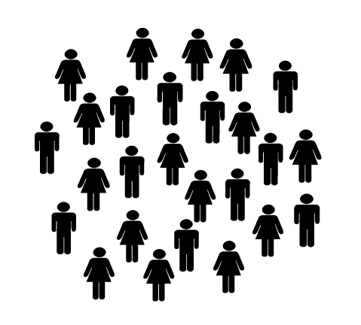
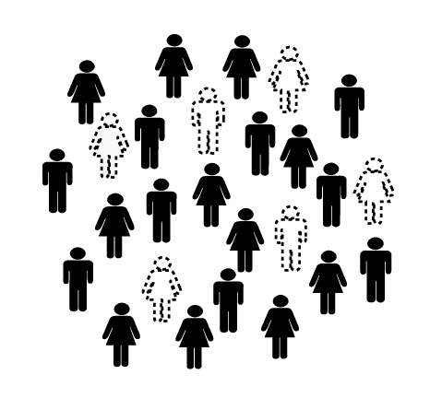




Population
Sample

Slide 2

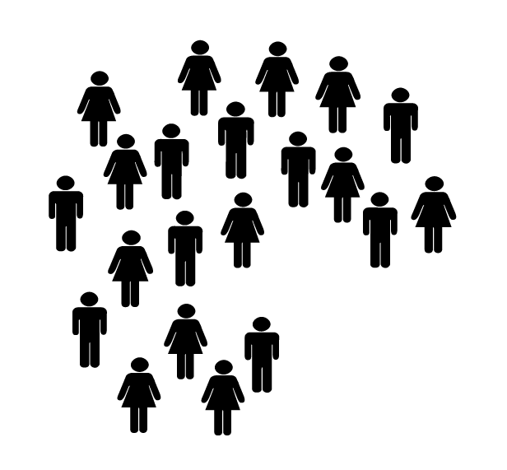



Convenience Sampling
Researcher
Researcher selects “units” to be included based on ease of obtaining them or simple availability

Slide 3
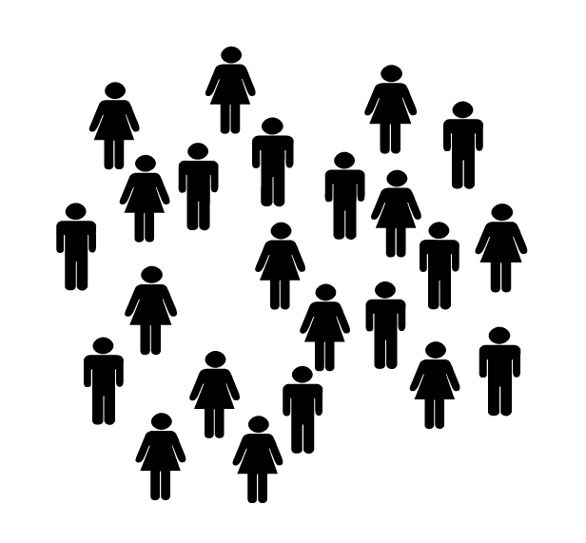
Volunteer Sampling
I’ll do it!
I’ll do it!
Researcher
I’ll do it!
Researcher uses only people who volunteer to participate
in the research

Slide 4

Network/Snowball Sampling
Researcher
Researcher selects a few participants, who then suggests others
who may be willing to participate

Slide 5







Simple Random Sampling
2, 6, 7, 12, 18
Each member of the population is listed in fashion (e.g., numerically)
and then a sample is drawn by randomly selecting members of the population

Slide 6


Systematic/Sequential Random Sampling
Desired Sample Size: 5
Population Size: 20
Increment: 20/5 = 4
A random start in the sequence is selected, and sample is selected by
selecting cases sequentially in the list to produce the desired sample size
Random Start: 2

Slide 7
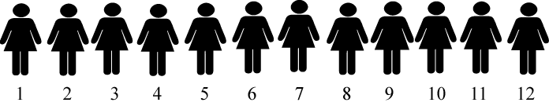

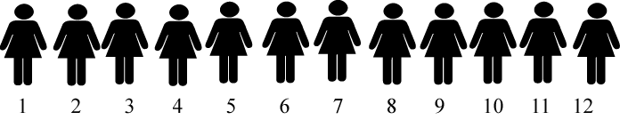
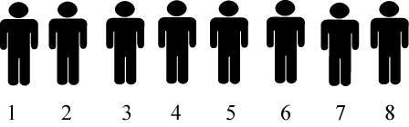

Stratified Random Sampling
Subgroups (“strata) created that separate members of the population on some important attribute (e.g., sex, race).
A random sample from each stratum is then drawn.

